Slide 1
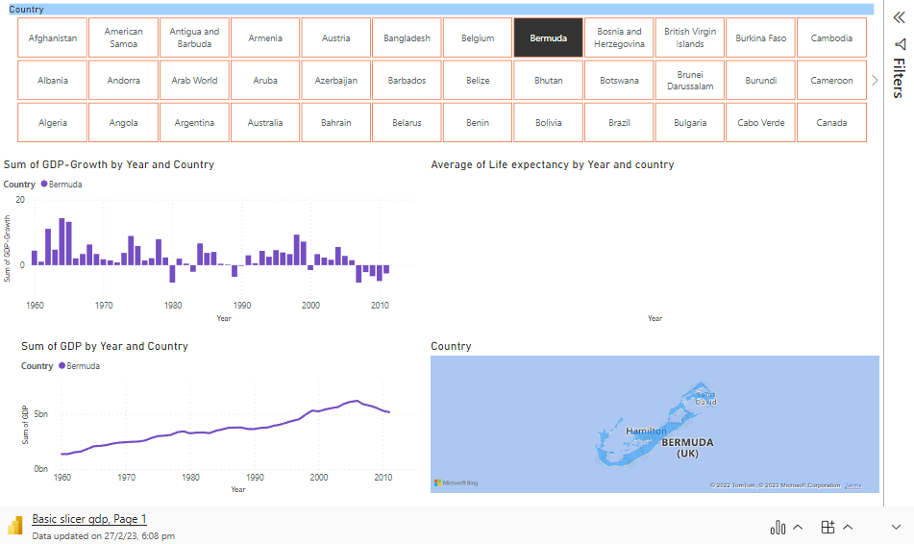
https://app.powerbi.com/groups/me/reports/5497693e-2a18-431f-b444-71018511541a/ReportSection

